Slide 1

CCPS 506
Comparative Programming Languages
Fall 2019
Lecture 9: Introduction to Rust

Slide 2
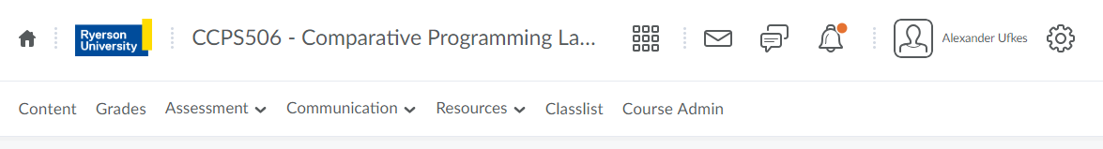
Course Administration
Getting closer! Three more weeks.
Don’t forget about the assignments!

Slide 3
Moving on…
…to imperative.
Rust is an imperative language. However, we’ll see many cool features that remind us of the functional languages we’ve seen.

Slide 4


Slide 5

Rust History
Grew out of a personal project by Mozilla employee Graydon Hoare in 2006
Mozilla began sponsoring the project in 2009
Officially announced in 2010
Rust compiler successfully tested in 2011
Pre-alpha version released in 2012
Rust 1.0, the first stable release, arrived on May 15, 2015
Youngest language we’ve seen so far
Open source

Slide 6
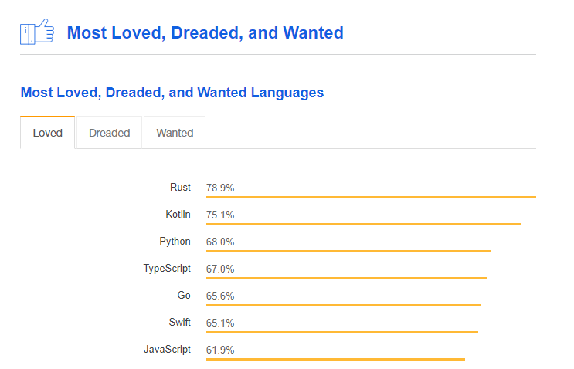
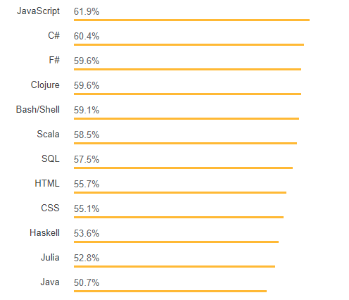
IEEE Developer’s Survey 2018
% using who want to keep using
Also #1 in 2017 and 2016!

Slide 7
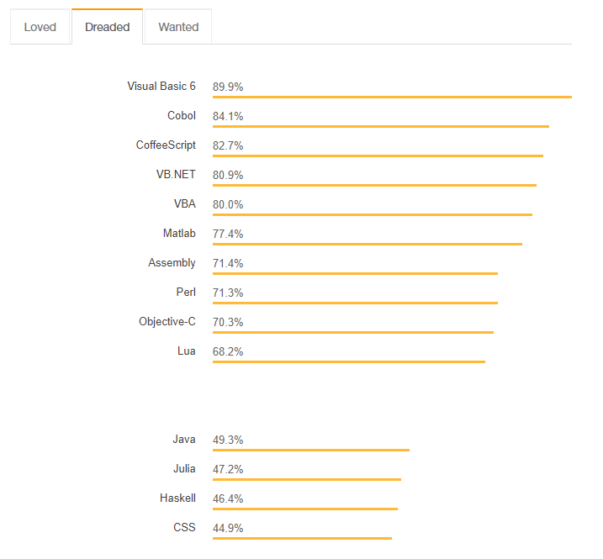
% using who’ve had enough
Could be worse

Slide 8
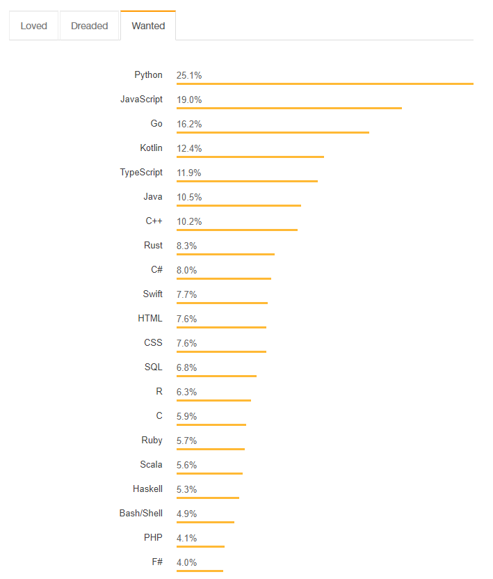
% who want to learn it

Slide 9
In Industry?
Mozilla in collaboration with Samsung
Parallel web browser engine
Dropbox
Magic Pocket file system, petabyte storage machines
Tor (The Onion Router)
Experimenting with porting to Rust (from C) for safety features.

Slide 10
Rust Features
Systems Programming Language:
In contrast with application programming languages.
System software includes things like operating systems, utility software, device drivers, compilers, linkers, etc.
System languages tend to feature more direct access to physical hardware of a given machine.

Slide 11
Rust Features
Syntax:
Similar to C/C++
Blocks of code delimited by { }
Familiar control structures supported (if, else, while, for, etc.)
Supports pattern matching! (match)
Need not use return, last expression creates return value
Functions largely composed of expressions

Slide 12
Rust Features
Memory Safety:
Rust is designed to be memory safe
Null or dangling pointers are not permitted.

Slide 13
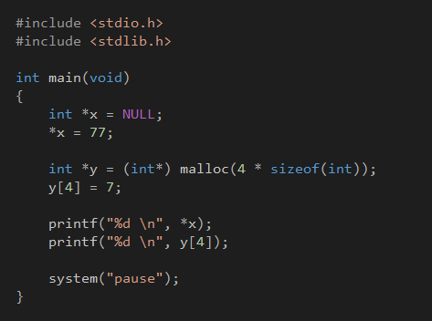
“Null or dangling pointers are not permitted”
In C, we’re allowed to try and write anywhere we want.
This code compiles!
It produces a run-time error when we try and index into pointer x.
Overrunning array bounds does not necessarily give a run time error!
Very unsafe use of memory.

Slide 14
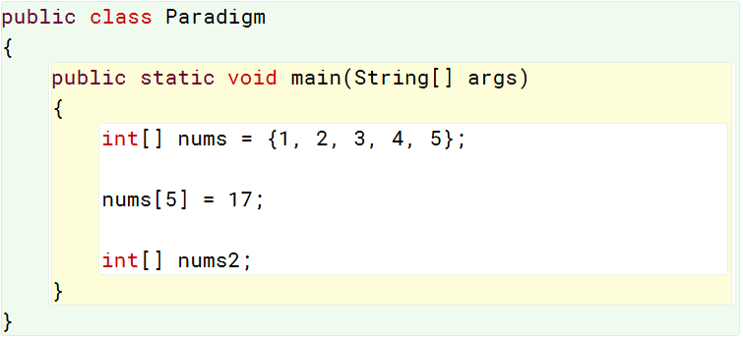
“Null or dangling pointers are not permitted”
Java is safer.
This code compiles, but always throws a runtime error when we access outside array bounds.
C/C++ only errors if going out of bounds accesses memory that your program doesn’t have write permission for.
Java still allows dangling references.
nums2 can be created without instantiating its object.

Slide 15
Rust Features
Memory Safety:
Rust is designed to be memory safe
Null or dangling pointers are not permitted.
What about linked lists? Null pointers are useful.
Rust defines an option type, which can be used to test if a pointer has Some value of None
What does this remind you of?

Slide 16
Rust Features
Memory Management:
Rust does not do garbage collection
Resource acquisition is initialization
RAII - Originated in C++
Constructor is used to acquire and initialize objects
Resource deallocation is done by the destructor.
No valid reference to object == no object.
Not so in Java! Up to garbage collector.

Slide 17
Rust Features
Types and Polymorphism:
Type system supports mechanism called “traits”
Directly inspired by Haskell’s type classes
Supports type inference for variables declared with let keyword.
Compile error if inference fails.
Keyword mut for mutable variables.

Slide 18
Rust Features
Pattern Matching:
Supports pattern matching!
Pattern matching is considered a sticking point for people learning Rust.
We already have experience with it

Slide 19
Rust & Safety
Strongly, statically typed
Strong typing means limited implicit type conversions at compile time.
C is happy to convert between numeric types without issue. Perhaps a compile warning in C++.
Java raises compile error if there’s a loss of precision (double to float for example).

Slide 20
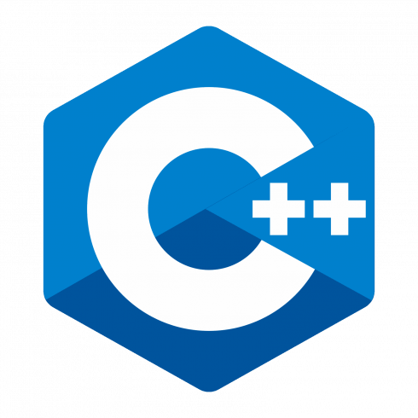
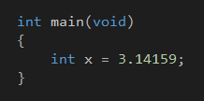
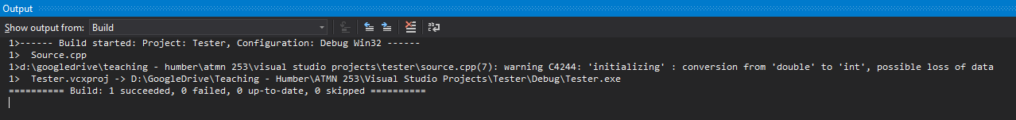
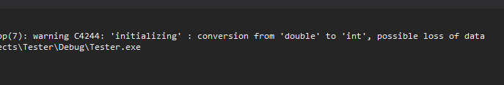

Slide 21

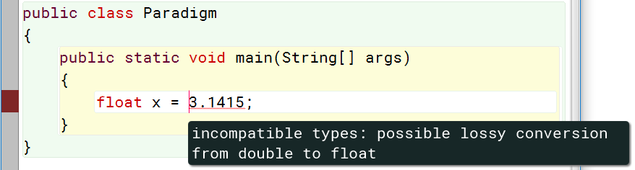

Slide 22
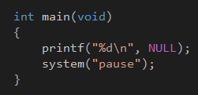
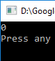
Rust & Safety
No “Undefined Behavior”
Null pointer dereferencing
Attempt to dereference address 0

Slide 23
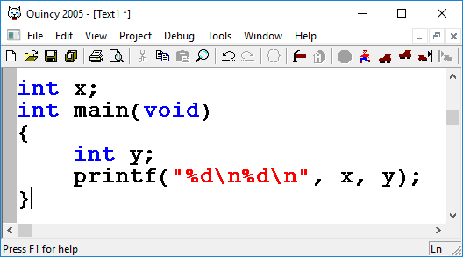
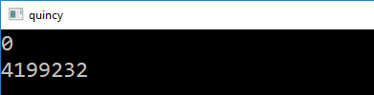
Rust & Safety
No “Undefined Behavior”
Null pointer dereferencing
Attempt to dereference address 0
Use of variable before it’s initialized
In C, we get whatever was in memory before that.
Only globals auto-initialize to 0

Slide 24
Rust & Safety
No “Undefined Behavior”
Null pointer dereferencing
Attempt to dereference address 0
Use of variable before it’s initialized
In C, we get whatever was in memory before that.
Only globals auto-initialize to 0
Array index out of bounds
May or may not cause runtime error (in C), depends who owns memory

Slide 25
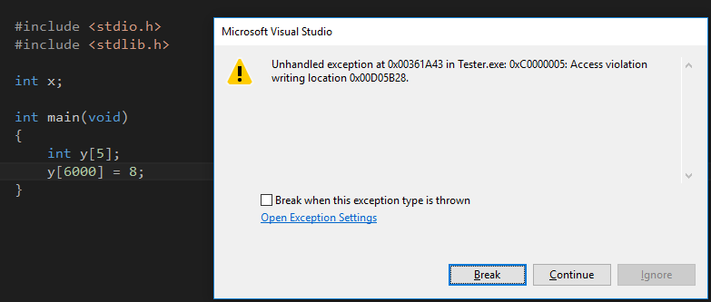

Slide 26
Rust & Safety
No “Undefined Behavior”
Signed integer overflow & optimization
X+1 > X
If overflow is undefined, compiler can just optimize this to simply true.
Dangerous if X can overflow!
Forcing compiler to consider overflow means we lose certain optimizations.

Slide 27
Rust Non-Goals
We do not employ any particularly cutting-edge technologies. Old, established techniques are better.
We do not prize expressiveness, minimalism or elegance above other goals. These are desirable but subordinate goals.
We do not intend to cover the complete feature-set of C++, or any other language. Rust should provide majority-case features.
We do not intend to be 100% static, 100% safe, 100% reflective, or too dogmatic in any other sense. Trade-offs exist.
We do not demand that Rust run on “every possible platform”. It must eventually work without unnecessary compromises on widely-used hardware and software platforms.

Slide 28
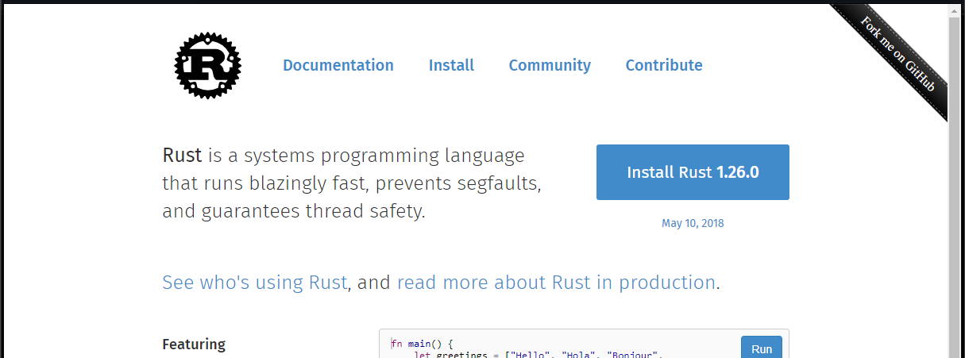
Installing Rust
https://www.rust-lang.org/en-US/index.html

Slide 29
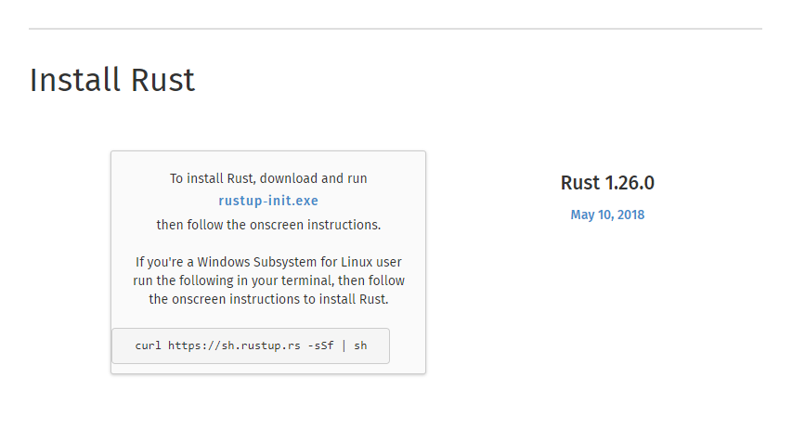
Installing Rust

Slide 30
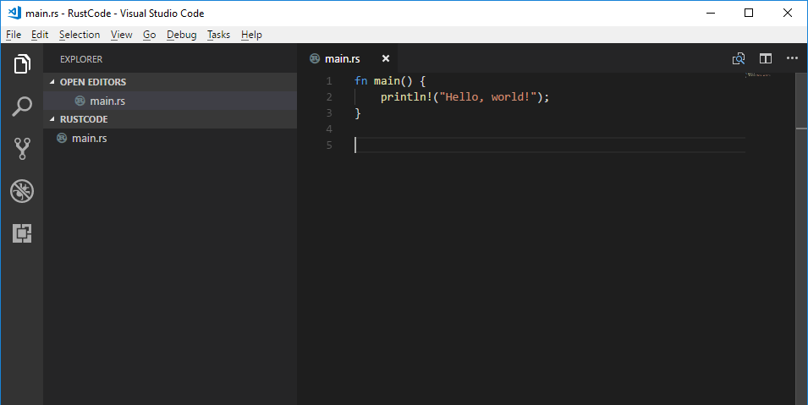
Editing Rust Code
Any text editor will do, but I like VSCode:
Visual Studio Code:
Supports Rust syntax coloring
Useful for other languages

Slide 31
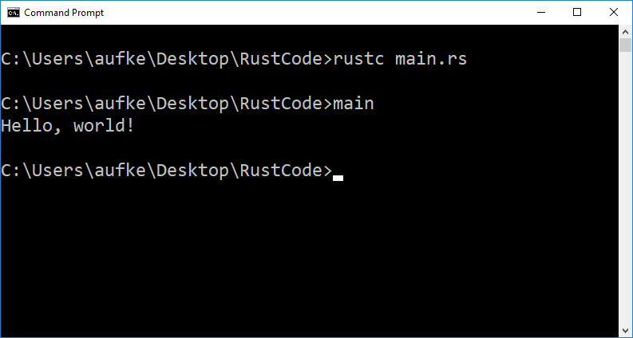
Compiling Rust Code
Command Line - rustc

Slide 32
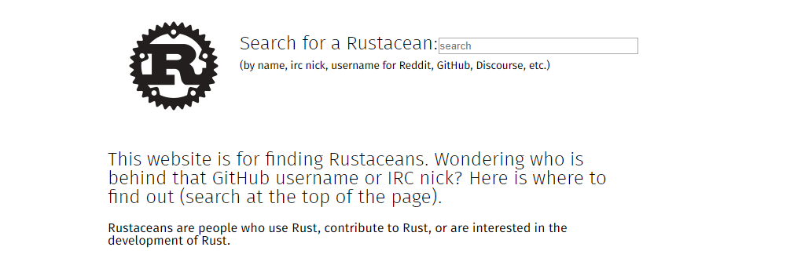
https://www.rustaceans.org/
Let’s see some syntax, fellow Rustaceans!

Slide 33
Much of the syntax is reminiscent of C/C++
fn main() {
println!("Hello, world!");
}
Like C, C++, Java, Haskell, and many others, main() defines the entry point for executing a Rust program.

Slide 34
fn main() {
println!("Hello, world!");
}
println vs println!
The ! indicates we’re calling a macro.
A standard function call doesn’t include !

Slide 35
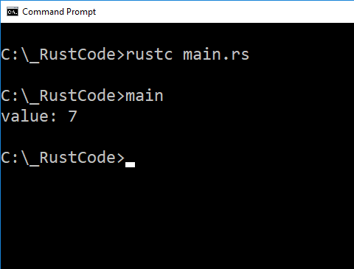
Variables
By default, Rust variables are immutable
Once initialized, can’t change.
Like final or const in other languages
Declare using let keyword:
fn main() {
let x = 7;
println!("value: {}", x);
}

Slide 36
fn main() {
let x = 7;
println!("value: {}", x);
}
Double curly braces in a println string acts as a C/C++ style placeholder

Slide 37
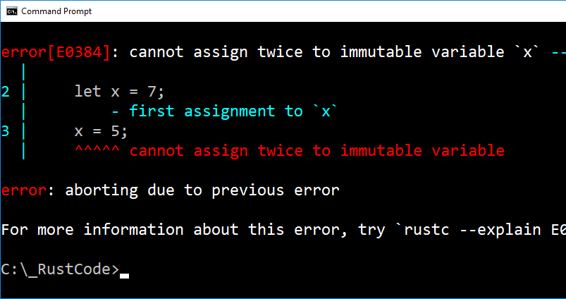
Variables
fn main() {
let x = 7;
x = 5;
println!("value: {}", x);
}

Slide 38
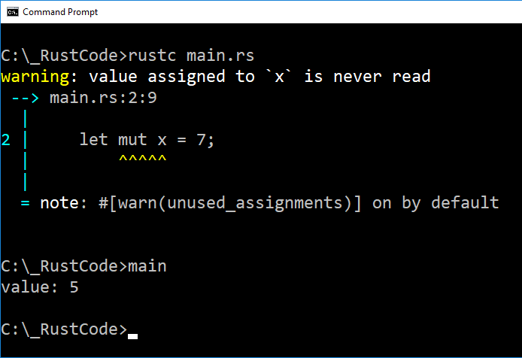
Mutable Variables
Use mut keyword:
fn main() {
let mut x = 7;
x = 5;
println!("value: {}", x);
}
We still get a warning, and it’s sensible.
We change the value of x before the initial value is ever read.
Pointless.

Slide 39
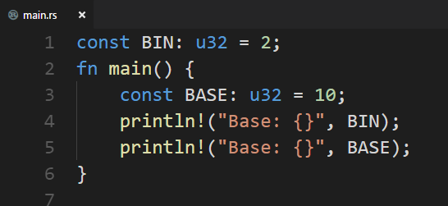
Constant/Global Variables
Rust still has them:
Use const instead of let
Always immutable
Can be declared in global scope, unlike let
Must indicate data type (u32)
More on types coming up.

Slide 40
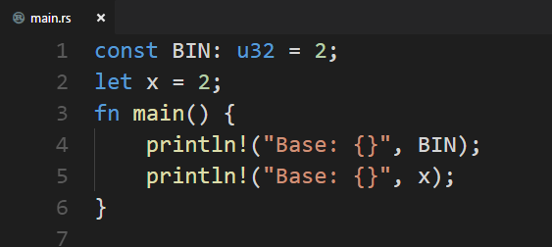
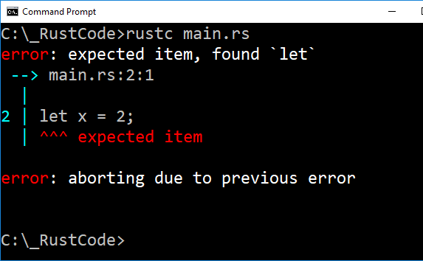
Constant/Global Variables
Rust still has them:

Slide 41
Shadowing
Variables with the same name?
BAD
int r = 10;
if (x >= 0) {
double r = Math.sqrt(x);
}
In Java, variables can have the same name so long as their scope does not overlap:
if (x >= 0) {
double r = Math.sqrt(x); }
else {
float r = 0; }
OK

Slide 42
Shadowing
Variables with the same name?
OK
int r = 10;
if (x >= 0) {
double r = sqrt(4.0);
}
C++ is less strict. Scopes can overlap, but they can’t be identical:
if (x >= 0) {
double r = sqrt(4.0);
float r = 0;
}
BAD

Slide 43
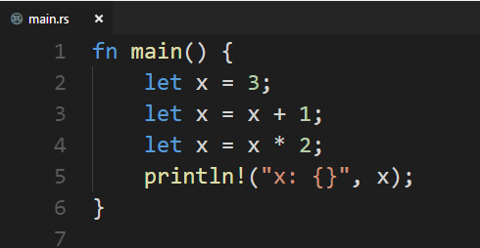
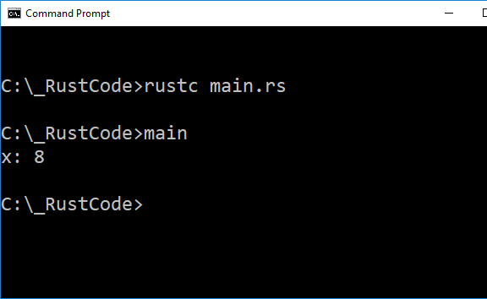
Shadowing
Variables with the same name?

Slide 44
Shadowing
Variables with the same name?
What we’re doing here is similar to re-binding in Haskell or Elixir.
This doesn’t work with mutable variables.
Think of this mathematically – We’re simply saying let x = something else.

Slide 45
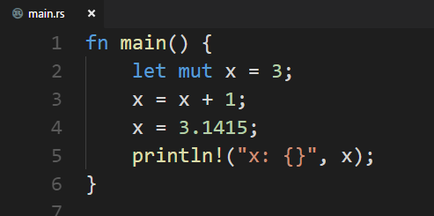
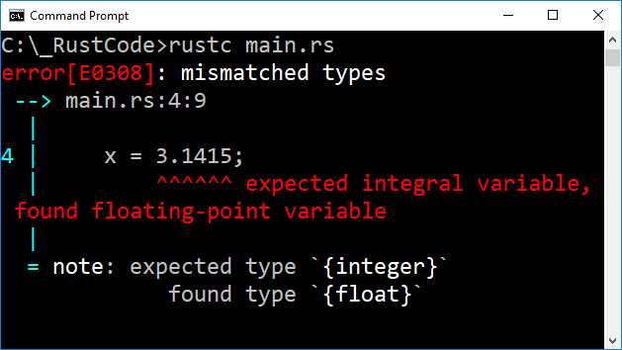
Shadowing VS mut
Why not just use shadowing? Why do we need mut?
Mutable variables are stuck with their type.
Can’t assign a value of a different type.

Slide 46
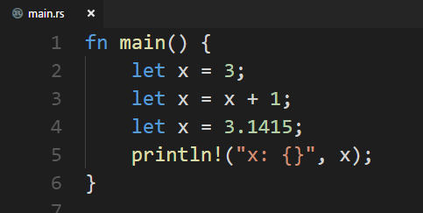
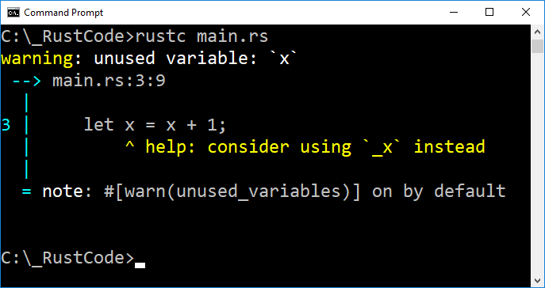
Shadowing VS mut
Why not just use shadowing? Why do we need mut?
With shadowing (rebinding) we can use different types.
Again, we get a warning because we’re rebinding before the original binding is ever used.

Slide 47
Shadowing VS mut
Why not just use shadowing? Why do we need mut?
With mut, we’re re-assigning a variable.
Storing a different value in the same variable.
The name still refers to the same place, thus the type must stay the same.
With shadowing, we’re getting a new variable in memory each time.
We’re changing what a given name is referring to.
We’re not changing the existing value.

Slide 48
Data Types
Two subsets: Scalar and Compound
Reminder: Rust is statically typed. Must know all variable types at compile time.
Scalar types represent a single value:
Rust has four: integers, floating-point, Booleans, characters.
Compound types group multiple values:
Two primitive compound types: tuples and arrays.

Slide 49
Scalar Types: Integers
Length | Signed | Unsigned
8-bit | i8 | u8
16-bit | i16 | u16
32-bit | i32 | u32
64-bit | i64 | u64
arch | isize | usize
Signed integers are stored using 2s comp
Arch will be 32 bits on a 32 bit system, 64 bits on a 64 bit system.
When not specified, Rust defaults to i32

Slide 50
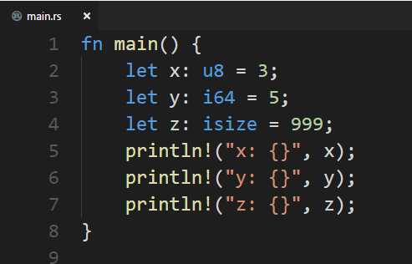
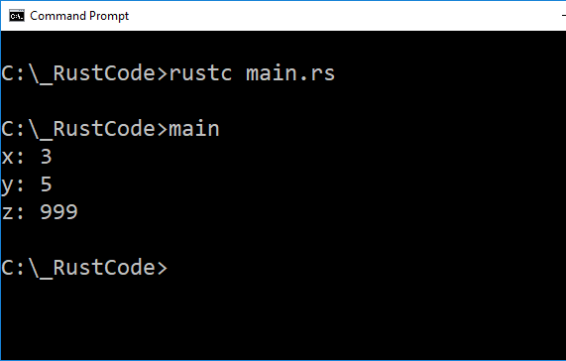
Specify Type?
Rust has type inference, but we can be explicit:

Slide 51
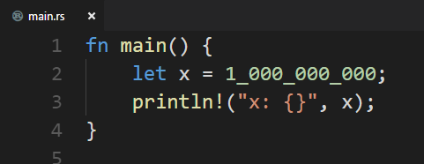
Integer Literals
In addition to just writing the value…
Notice the _
This is a handy visual sugar
Hard to count the zeroes in 1000000000. What number is this?
Easy to see 1_000_000_000 is one billion.
Number literals | Example
Decimal | 98_222
Hex | 0xff
Octal | 0o77
Binary | 0b1111_0000
Byte (u8 only) | b'A'
Bytes can be character literals

Slide 52
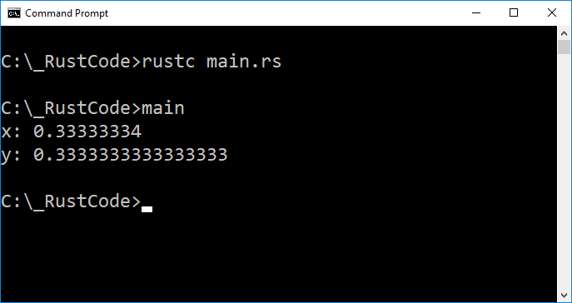
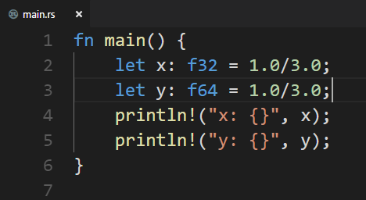
Scalar Types: Floating Point
Two kinds – 32 and 64 bit (float and double, single and double precision)
Represented using standard IEEE-754
Default

Slide 53
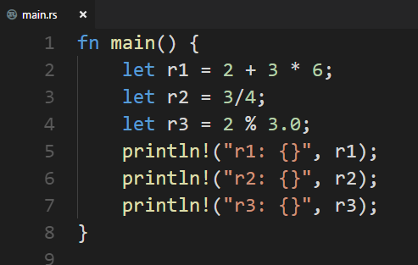
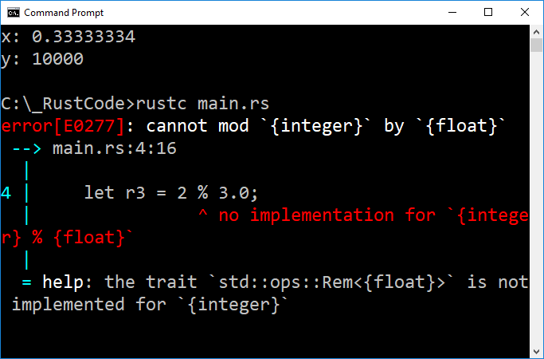
Numeric Operations

Slide 54
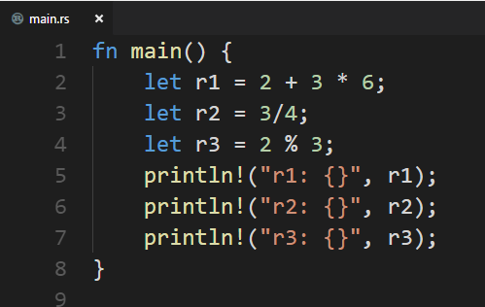
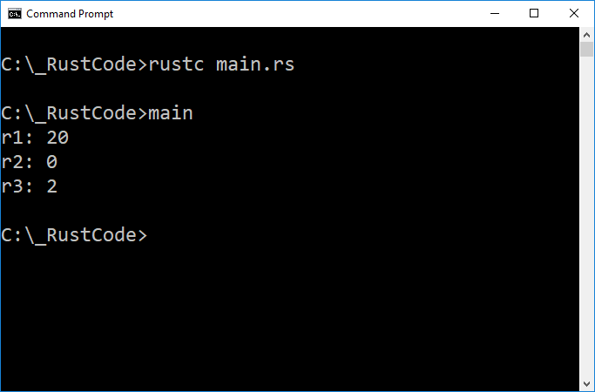
Numeric Operations

Slide 55
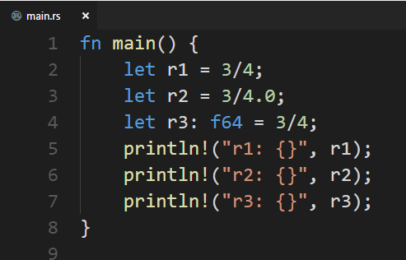
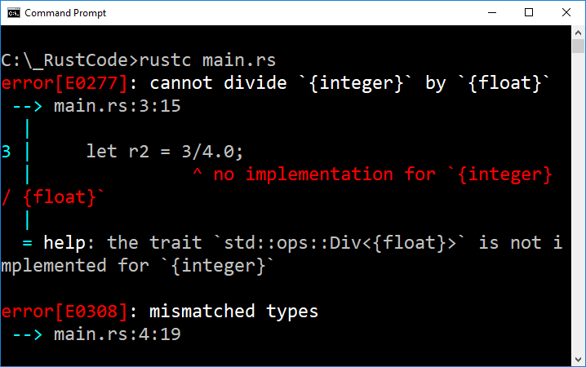
Mixed Expressions?
Rust doesn’t mess around when it comes to implicit type conversion.

Slide 56
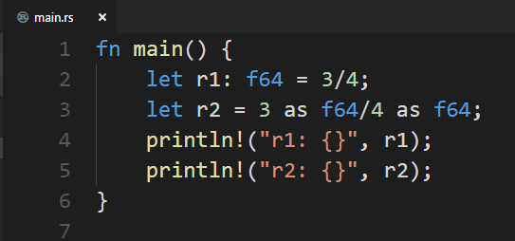
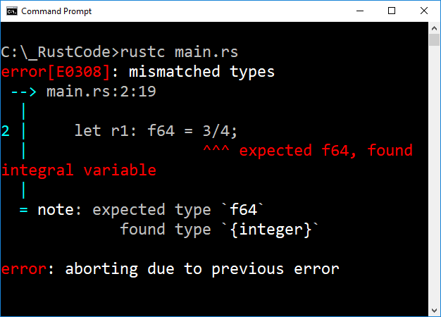
Mixed Expressions?

Slide 57
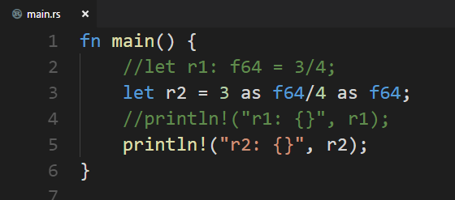
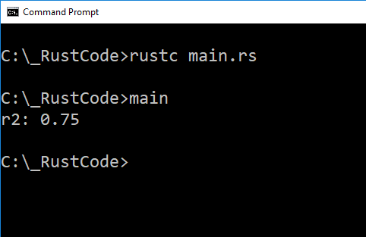
Mixed Expressions?
Cast using: as type
Comments same as Java/C/C++
Both block and single-line
Finally!

Slide 58

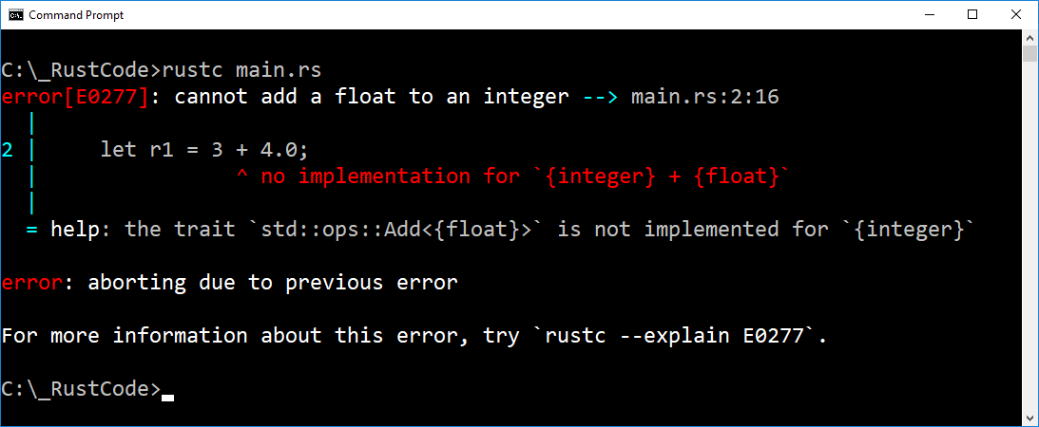


Mixed Expressions?
Division is weird, good reason to avoid implicit conversion…

Slide 59
Why?!
Adding float to int means converting the integer to a floating point type, then adding.
Processor can’t add different types – float and int arithmetic is done in a different physical location in the CPU.
It’s possible to introduce errors in precision!
An integer in binary is exactly precise.
The same value represented as a floating point may lose significant digits.
Most languages don’t even warn about this – Rust doesn’t allow it at all.

Slide 60



IEEE-754

Slide 61


Scalar Types: Boolean
true, false. Easy:

Slide 62


Scalar Types: Characters
Rust supports Unicode:

Slide 63

Compound Types: Tuples
Tuples can be heterogeneous, and we need not specify type. Rust can infer it.

Slide 64


Accessing Elements
Pattern Matching! De-structuring!

Slide 65


Accessing Elements
Can also access directly:
Can we go out of bounds?

Slide 66


Accessing Elements
Out of bounds:
Compile error in Rust

Slide 67


Accessing Elements
Can we fool it?
Nope.

Slide 68


Compound Types
Arrays
Arrays in Rust are: homogeneous, zero-indexed, fixed in size.

Slide 69


Accessing Elements
Out of bounds:
Runtime error, much like Java. Stops invalid memory from being accessed.

Slide 70


Array of Tuples
Same rules as Haskell:

Slide 71


Array of Tuples
Same rules as Haskell: Tuple types must be the same

Slide 72
Types & Literals: Summary
4 Scalar types:
Integer – u8, u16, u32, u64, usize, i8, i16, i32, i64, isize
Floating Point – f32, f64
Boolean – bool (true, false)
Character – Unicode: ‘Z’, ‘a’, ‘&’, ‘\u{00C5}’, etc
2 Compound types:
Tuple – heterogeneous
Arrays – homogeneous
Rust supports other data structures such as strings and vectors. These are not base types, but very useful.

Slide 73


Strings
String literals and escape characters work similar to Java

Slide 74

S

Slide 75

Functions
We’ve seen main()
Returns nothing, accepts no arguments.
Convention for naming functions is snake_case.
Words separated by underscores.

Slide 76

Functions
Unlike C/C++, Rust doesn’t care about ordering

Slide 77


Parameters
identifier: type
Parameters separated by commas.
Indicating type is mandatory
Nothing too unusual here

Slide 78


Careful Now…

Slide 79
Statements & Expressions
Rust is primarily expression based, but still has statements.
Two types of statements:
Declaration statements return nothing
Expression statements return empty tuple ()
let x = 6; // This is a declaration statement
The above does not return a value. We can’t do the following:
let y = (let x = 6);

Slide 80
Statements & Expressions
Rust is primarily expression based, but still has statements.
Two types of statements:
Declaration statements return nothing
Expression statements return empty tuple ()
5 + 2; // This is an expression statement
The above does return a value!
5 + 2 is an expression. It returns 7.
5 + 2; is an expression statement. It returns ().

Slide 81


Statements & Expressions
let y = (let x = 6);

Slide 82



Statements & Expressions
OK
Not OK… but what does this error mean?

Slide 83
Statements & Expressions
Variable y gets re-assigned.
The expression statement (y=8) returns an empty tuple in Rust.
Can’t assign an empty tuple to a variable declared to hold i32!

Slide 84

Statements & Expressions
Here:
Value of x will be 3
Value of y will be () empty tuple

Slide 85
Statements & Expressions
x + 6 // This is an expression
x = 5 + 6; // This is an expression statement // containing an expression
Expression
Declaration statement
Expression statement
let x = 6;
In fact:
Expression

Slide 86

Statements & Expressions
Creating a new scope block?
We can do this in Java and C/C++, though again it isn’t so common:
Not a control structure or method, just a block of code with its own scope

Slide 87

Statements & Expressions
Scope blocks like this are expressions in Rust:
There’s a few things going on here:
We’re trying to bind a value to y.
Thus, the block { } should return a value.
Notice there’s no semicolon after z + 1
z + 1 is an expression.
Adding a semi-colon would make it an expression statement.
Thus, the block { } would return ().
Probably not what we want.

Slide 88
Statements & Expressions
Scope blocks like this are expressions in Rust:
expression!
let y = { let x = 3; x + 1 } ;
This whole thing is a declaration statement

Slide 89

Statements & Expressions
Scope blocks like this are expressions in Rust:

Slide 90


Return Value
Think of functions the same way.
The last line should be an expression – no semi-colon.
-> type
Explicitly indicate return type
Result of expression gets returned

Slide 91


Return Value
Add semicolon? It becomes expression statement, returns (), type mismatch:

Slide 92

Control Flow

Slide 93


if / else
As with other imperative languages, the else is optional.
Recall that this is not the case with Haskell!
We were required to have a complete if-then-else

Slide 94
Boolean Conditions?
Mandatory.
In C/C++ (and Elixir, with caveats):
Non-zero values are “truthy”.
Only 0 is considered false.
In Java (and Haskell, Rust):
Conditions must be Boolean
if (3.141592)
System.out.println(
“Compile Error”);
if (3.141592)
cout << “Valid!” << endl;
Converting non-Boolean to Boolean requires implicit conversion, which, as we’ve seen, rust does not do.

Slide 95


Boolean Conditions?
Mandatory.

Slide 96


Ah! But can we cast?
Nope.

Slide 97

if / else if / else
As we’d expect.
Notice we use { } even though there’s only one statement per branch
This is required.
Why? Because Rust treats these as blocks whose last line can be an expression.
Yields potential for inlining if/else structures!

Slide 98

if / else if / else

Slide 99
if / else if / else
let state = {…}; is a statement
{…} is an expression that will evaluate to a string. if == expression!
“Frozen”, “Liquid”, or “Boiling”
Each option is in a scope block { }
The return value of a scope block is the last expression
Leaving the ; off makes these strings expressions.

Slide 100

if / else if / else

Slide 101


Problem?
Remember: Strong, static typing. No implicit conversion!

Slide 102

Looping

Slide 103



Looping
Just like while(true){} in Java

Slide 104


Conditional Looping: while
Similar in form to other imperative languages.
Rust understands +=
We’ve declared n as mutable. Why?

Slide 105


Conditional Looping: for
Similar to an enhanced for loop in Java:
Invoke iter() function of array nums
elem takes the value of each element in the array.
Safe! Never go out of bounds.

Slide 106

Conditional Looping: for
Use .. to create a range
Create a Range containing 0 to 9
Top of range not included!
Just like substring() in Java

Slide 107

Conditional Looping: for
Not as safe!
Here we have to be careful
Higher chance of accidentally overrunning array bounds

Slide 108


A loop is a loop is a loop
Wait, what?

Slide 109
Wait, what?
We didn’t specify the type of i, but shouldn’t it default to i32?
Rust infers type, i32 should be default.
HOWEVER!
Rust doesn’t allow signed integers to be used as array indexes!
It inferred the type as unsigned! Thus checking less than zero is pointless.

Slide 110


Rust doesn’t allow signed integers to be used as array indexes!

Slide 111


Need to adjust our logic a bit…

Slide 112
Fantastic Rust Reference:
https://doc.rust-lang.org/book/second-edition/

